Slide 1
How to use Quick Assist Windows 10

Slide 2
Before allowing access …
Since this feature gives a person complete control over another's PC, you should only use it with someone you trust.
If you are the person giving assistance, you need to use a Microsoft account.
If you are receiving assistance, you don't have to be signed in to a Microsoft account. As long as you're comfortable with allowing that person access to your Windows 10 PC, the following steps will get everything working.

Slide 3
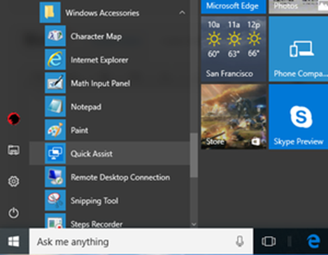
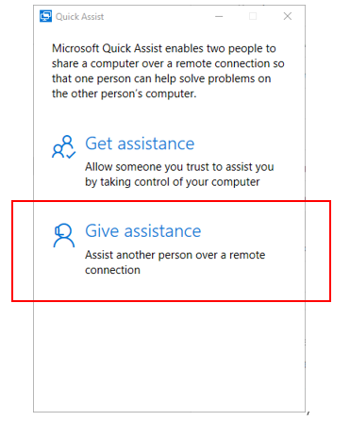
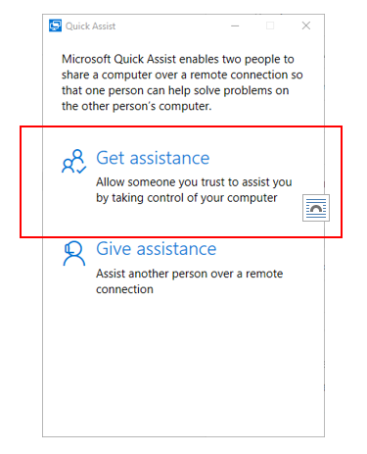
Select the Windows Start button
Windows Accessories OR type Quick Assist in Search Box
Quick Assist. Hit Enter

Slide 4
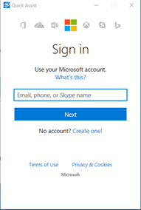
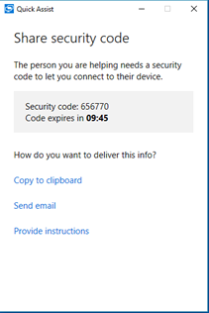
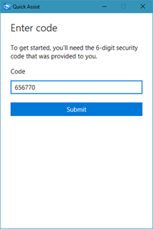
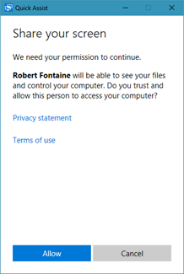
Person receiving assistance
Person giving assistance

Slide 5
Controls
Task Manager
Stop
Annotate
Messages
Multiple
Screens
Full Screen
Restart
Pause

Slide 6
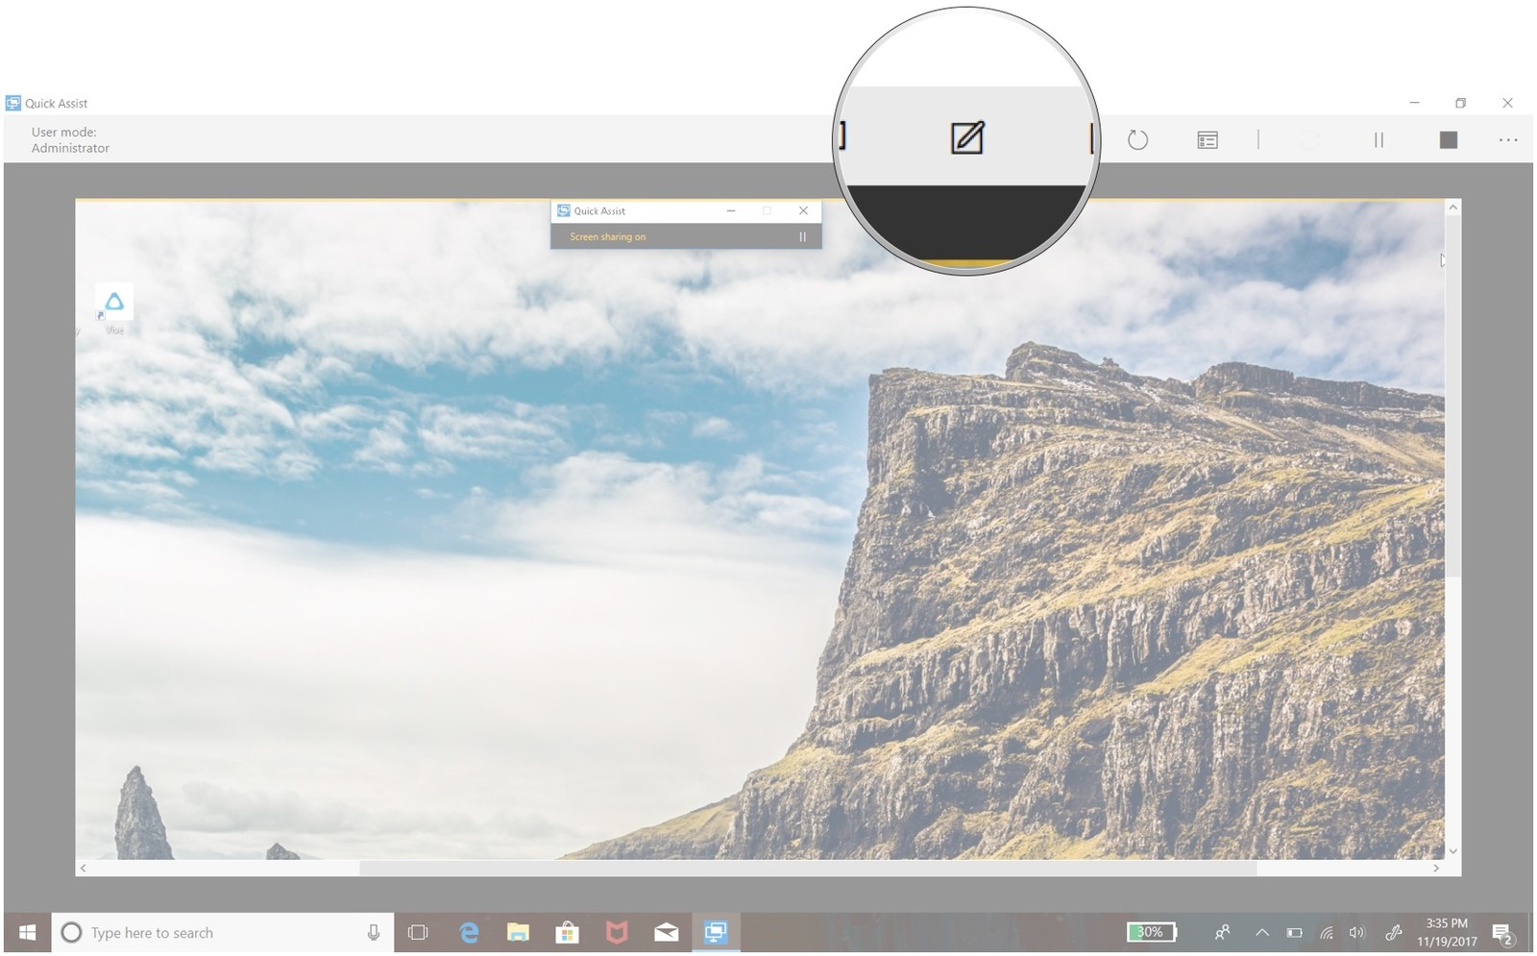
To annotate both screens, click the Annotate button. This allows the person giving assistance to draw directly on both screens using their mouse cursor. This is useful for jotting down notes or highlighting parts of the screen you want to bring their attention to. Any annotations you make will be removed when Quick Assist is closed.

Slide 7
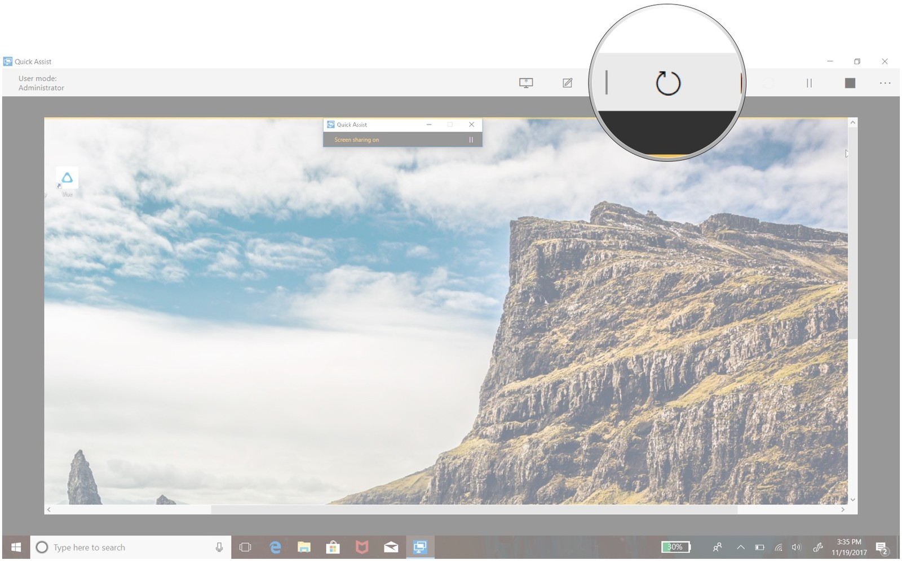
To restart the other PC, click the Restart button. Reboots the other person’s PC, but doesn’t disable Quick Assist. The helper will regain access to the other person’s desktop after their machine reboots.

Slide 8
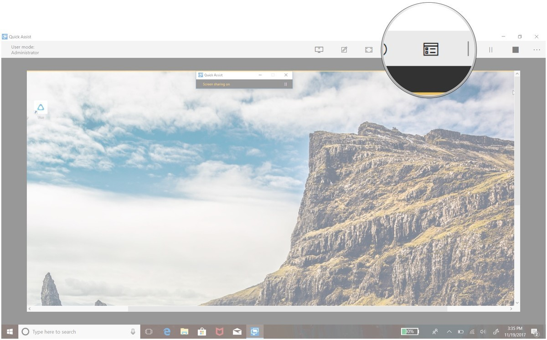
To open the Task Manager on the other PC, click the Task Manager button. Lets the helper open the other person’s Task Manager. This is useful if you need to check what programs they’re running

Slide 9
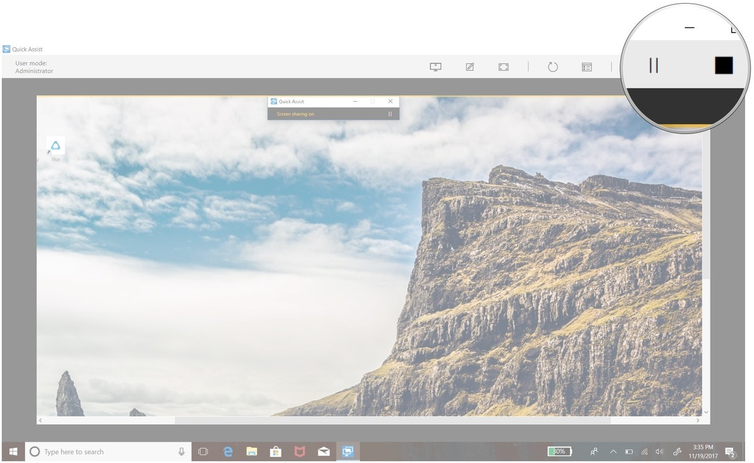
To pause or stop the connection, click the Pause or Stop button. The connection can be resumed by hitting the Play button in the same spot.

Slide 10
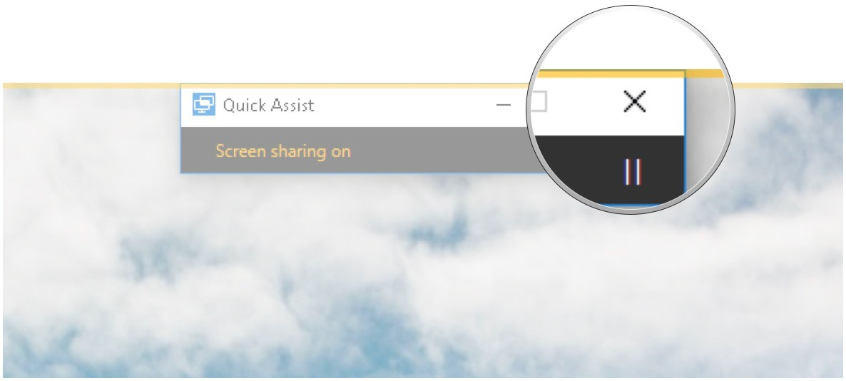
If the person receiving assistance would like to stop the Quick Assist, they can click the X in the top-right corner of the small window on their screen.

