Slide 1
Scam & Cyber Crime
Prevention
‘Lets talk Scams’ with Computer Pals
PRESENTATION BY
SENIOR CONSTABLE SANDRA FRAIETTA
CRIME PREVENTION OFFICER
Northern Beaches Police Area Command
11 May 2022

Slide 2
Our workshop aims
Promote awareness of the types of scams occurring in our community
Understand how scammers operate so you can protect ourselves against them
Know what to do if you experience a scam

Slide 3
About scams and cybercrime
Cyber crimes are crimes where computers or other types of technology are used in the commission of the offence (Australian Federal Police)
A scam is ‘an illegal plan for making money… that involves tricking people’ (Cambridge Dictionary)
There are many types of scams, but many involve identity theft, whereby criminals access your personal details and use them to steal money or other types of benefits
You can be scammed online, over the phone, by post, via advertisements or in person (door to door)

Slide 4
Understanding how scammers operate
Scammers are constantly looking for new opportunities to exploit us such as online shopping scams, NBN scams, fake bushfire charities, ATO scams, crypto currency scams
The common element is people tricking you into giving them personal details or money
If we learn how scammers operate, we can learn how to protect ourselves

Slide 5
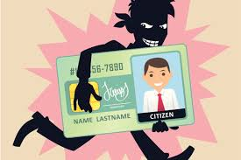
Identity theft
Scammers use many forms of Identity theft, including stealing from letterboxes and stealing online information.
These scammers will steal personal information including:
name, address, date and place of birth
driver’s licence, passport, Medicare and/or Tax File number.
credit card details, credit cards and PIN numbers.
online account username(s), login details and passwords .
If someone steals your identifying information they may be able to access your accounts or use your identity to commit fraud or open bank accounts in your name
Notes:
Make sure if you are receiving a credit card or licence in the mail that you look out for it in the mail. If you haven’t received it be sure to contact your provider.
1 in 4 Australians have been a victim of identity crime at some point in their lives.

Slide 6
Protecting yourself against identity theft
Make sure your letterbox is locked, clear it out regularly and have someone trustworthy clear it while you’re away
Ensure discarded personal documents such as bills, insurance renewals or health care records are torn up so personal details can not be identified
Don’t use public Wi-Fi to do banking and other sensitive transactions (they may not be secure) – Use a VPN (Virtual Private Network)
Limit the information you share on social media (don’t disclose your birthday, address or when you are going on holidays)
Do not accept friends requests from people you don’t know
Notes:
Don’t use public wi fi to access personal information such as bank accounts. Think about a VPN. virtual private network – IP ADDRESS
A virtual private network gives you online privacy and keep you anonymous by creating a private network from a public Internet connection. Most important, VPN services establish secure and encrypted connections, guaranteed to provide greater privacy than even a secured Wi-Fi hotspot. Google VPN and will give you more info.

Slide 7
Hacking
Hacking occurs when a scammer gains access to your personal information by using technology to break into your computer, mobile device or network. Hacking often involves sending emails with attachments or a link that may appear legitimate, that install Malware (Malicious software) on your computer when you open them.

Slide 8
Common examples of hacking
Adware – If your computer has been infected with adware, advertisements will automatically be on your computer.
Spyware – Spies on a user’s activity without their knowledge. It can spy on keystrokes, your data and your information.
Ransomware- Encrypts your device/computer, so it freezes and forces you to pay a ‘ransom’ to have it unlocked.
Notes:
How do you get ADWARE Adware normally comes in software/programmes that you download from the internet – usually freeware or shareware – and it secretly installs itself onto your device without your knowledge.
Free software which contains some ads may be annoying but is not illegal
How do you get SPYWARE Some common ways your device might become infected with spyware include: Accepting a prompt or pop-up without reading it first. Downloading software from an unreliable source. Opening email attachments from unknown senders
How do you get RANSOMWARE Typically, a computer becomes infected with ransomware through a malicious email, containing a malicious link or file attachment. Once you click either of those, the ransomware will start doing its thing, installing itself on the victim’s computer.

Slide 9
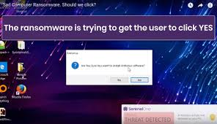
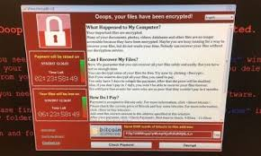
What to look out for
Icons or strange files on you computer desktop which you cannot remember downloading
Your computer is freezing or crashing
Files have been modified or deleted
A popup screen appears on your computer
Notes:
If you think your computer has been infected with malware, install and run anti-malware and firewall software. This may help fix minor infections. Otherwise have an IT specialist to fix your computer.

Slide 10
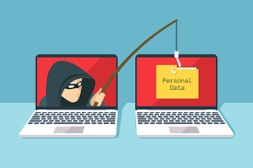
What is Phishing?
Phishing scams are attempts by scammers to trick you into giving out your personal information such as your bank account numbers, passwords and credit card numbers via email.
Phishing emails often present as being from legitimate organisations such as telecommunications companies, utility providers or government departments.
Notes:
Scamwatch indicates that Phishing is by far the most commonly reported type of scam in Australia but you will see later how it compares with how much money is lost.

Slide 11
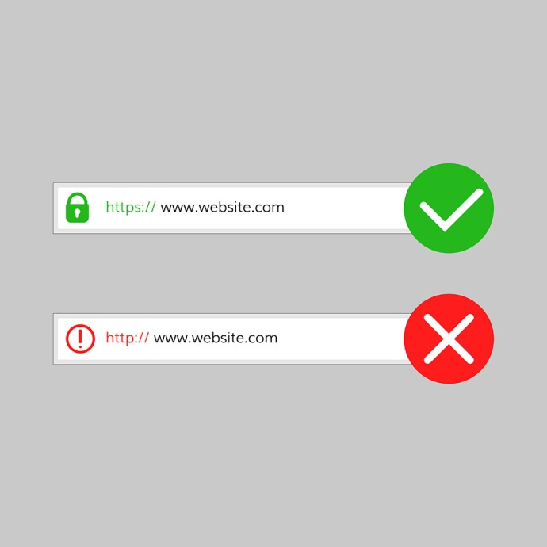
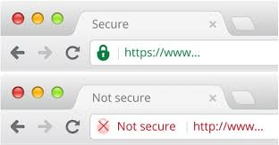
Signs of Phishing
Phishing messages are designed to look genuine, and often copy the format used by a legitimate organisation the scammer is pretending to represent, including their branding and logo.
Notes:
Scamwatch indicates that Phishing is by far the most commonly reported type of scam in Australia

Slide 12
What to look out for
Often if you hover your cursor over the sender’s email address it will be clear if it is not legitimate
Scam emails often demand urgent payment to avoid a penalty or missing out on financial reward
Notes:
If you check the sender on a spam or scam email you might note the email address is not related to the organisation the sender claims to represent. Spelling mistakes are also an indicator of a scam email.

Slide 13
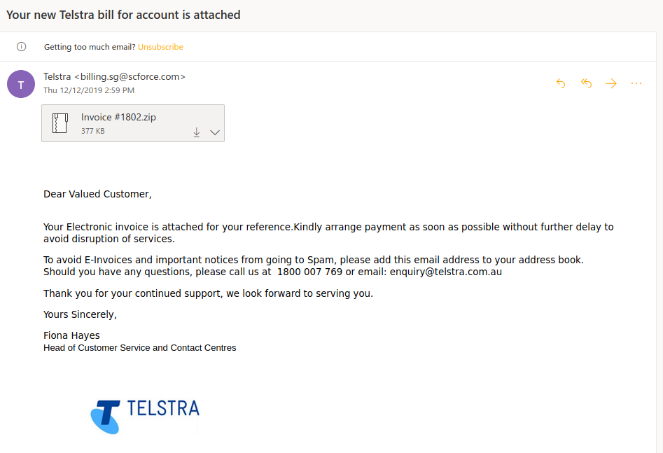
Phishing – Telstra email scam
Email address is not from Telstra
Zip File – Don’t Open will contain Malicious Software
Not personally addressed
Telling you to add email address to your address book

Slide 14
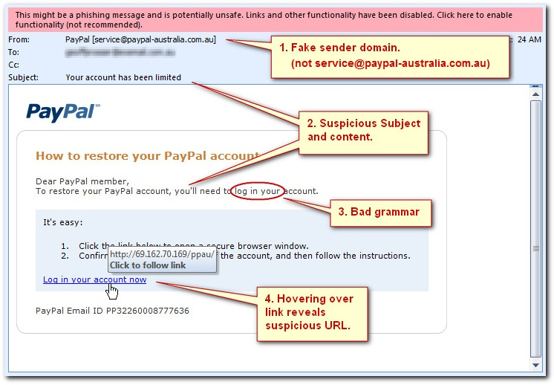
Phishing – PayPal email scam

Slide 15
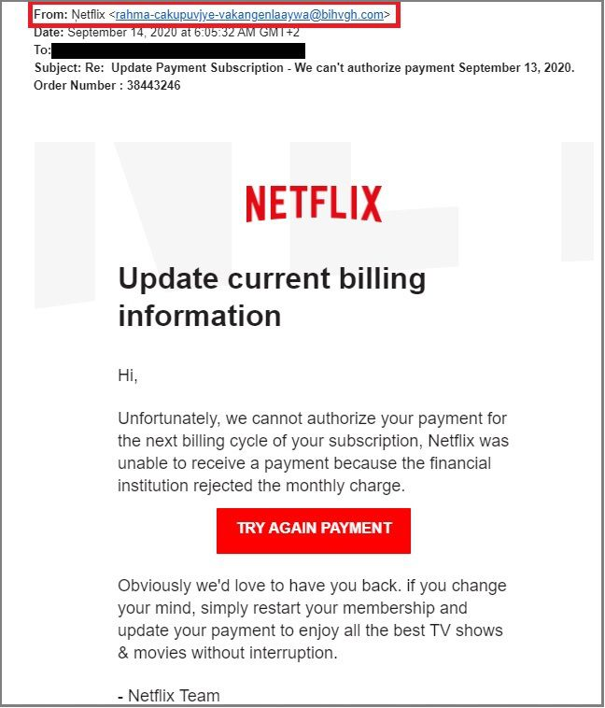
Phishing Emails
Suspicious email address
Not addressed correctly
Asking to click on payment

Slide 16
What to look out for
Unaddressed or generically addressed emails, such as “Dear Customer”.
Badly written emails with broken sentences, spelling mistakes, grammatical errors and words in a foreign language.
Emails that show account information that doesn’t match your subscription or phone account details. You can refer to the official website for accurate account information.
Requests for your credit card, passwords, account details or personal information – either by replying to the email, or by asking you to “click a link” and fill in a web form.
Suspicious looking URLs, or ones that don’t directly point back to the intended website.
Emails that include a zip file, an .exe or other suspicious attachment.
Notes:
Exe files are executable files. When you download programs they are executable files and sometimes come in the for of a zip file first. Once you unzip the file there may be an executable file in there. Once you click on that, that’s when you may be opening malicious software.

Slide 17
Investment scams
Investment scams account for the greatest financial loss among Australians scammed in 2021.
Investment scammers may:
promise high and quick financial returns
offer tax-free benefits and low-risk investments
suggest they have ‘inside information’ and invite you to invest before a public float.
Notes:
Has the greatest amount of loss and it is one of the most least reported.
That could be because the loss is greater.

Slide 18
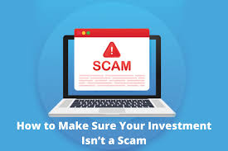
Investment scams
There are three main types of investment scams in Australia:
The investment offer is completely fake
The investment exists, but the money you give the scammer doesn’t go towards that investment
The scammer says they represent a well-known investment company – but they’re lying

Slide 19
Protect against investment scams
If you are considering investing, always check if the financial advisor is registered via the ASIC website. Any business or person that offers or advises about financial products must hold an Australian Financial Services (AFS) licence.
https://asic.gov.au/for-finance-professionals/afs-licensees/financial-advisers-register/
Also check ASIC's list of companies you should not deal with.
https://moneysmart.gov.au/companies-you-should-not-deal-with
Notes:
Steve is a 65-year-old who lives alone in retirement.
Not long after his wife’s death, he received an unexpected call about an investment opportunity. The cold-callers sounded very professional and seemed to have excellent knowledge of investment matters. They answered all of Steve’s questions and their initial contact was followed up with calls from ‘senior advisors’.
Over the next 12 months, Steve made a number of transfers to the 'investment professionals', initially starting with $10 000. He was referred to a very professional looking website and set up a login account, which showed his money increasing in value as the market ‘went up’. Confident the system was working, he invested more money, to a total of $200 000.
Always seek independent financial advice before making an investment.
He only realised that the investment scheme was a scam when the website went down and he could no longer access his account or contact the offshore group by phone.
He then did some research and discovered the company was fake and not registered with the Australian Securities Investment Commission (ASIC) but he was too embarrassed to tell anyone or report it to police. He was contacted by police after they discovered his name on bank transfers made to known fraudsters.

Slide 20
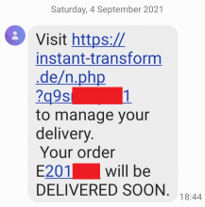
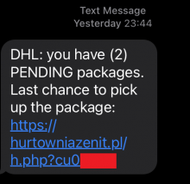
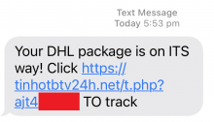
Missed Delivery, Call or Voicemail (Flubot) Scams
The text messages ask you to tap on a link to download an app to track or organise a time for a delivery, or hear a voicemail message. However, the message is fake, there is no delivery or voicemail, and the app is actually malicious software called Flubot.
If you receive one of these messages, DON’T click or tap on the link. Delete the message immediately.
Notes:
Every time I talk about these types of scams someone tells me that they have received these types of messages.

Slide 21
Missed Delivery, Call or Voicemail (Flubot) Scams
→ What happens if you click or tap the link
Clicking/tapping the link could lead to downloading malware (malicious software) to your phone.
→ What to do if you’ve downloaded the Flubot
Act immediately. If you have already clicked the link to download the application, your passwords and online accounts are now at risk from hackers.
The Scamwatch website has information regarding steps on removal of the software.
https://www.scamwatch.gov.au/news-alerts/missed-delivery-call-or-voicemail-flubot-scams

Slide 22
Remote Access Scams
Remote access scammers phone you pretending to be from a large telecommunications or computer company (e.g. Telstra, NBN, Microsoft) or a technical support service.
They try to convince you that you have a computer or internet problem and get you to install a software program to ‘fix’ the problem.
This gives them control of your computer and they either steal your information or demand money to return access to you.
Notes:
On the 6th of October, 2021 a 91 year old male from the local area received a call from an Indian sounding male named Ian NICHOLSON who stated that his bank details had been hacked and he was calling to assist him in fixing the issue.
During the phone call, the elderly male was deceived into downloading software to his computer that would give the caller access and use of his computer.
From there, NICHOLSON accessed his bank account and transferred $3,000 AUD to another bank account.
.
NICHOLSON then attempted to transfer further funds from another bank account of his but the transaction was blocked due to suspected fraudulent activity. As the elderly male could see these transfers happing in real time on his computer and saw the alert of suspected fraud, he questioned NICHOLSON's actions where the call abruptly ended.
.
Following these incidents, STARLING contacted his bank regarding the matter.
STARLING's bank account compromised;. He lost $3000.

Slide 23
Tips to stay safe online
Use strong passwords, face or fingerprint ID
Ensure passwords are minimum 12 characters and include uppercase and lowercase letters, symbols and numbers
Install anti-virus software & keep it up to date
Secure your Bluetooth and wifi with passwords

Slide 24
Tips to stay safe online
Do not open attachments unless you are certain they are legitimate
Do not follow links from emails and provide personal information
Do not allow anyone remote access to your computer unless you have engaged someone reputable for IT support
Check email addresses from senders
Check if websites are secure
Beware when someone contacts you and demands urgent payment

Slide 25
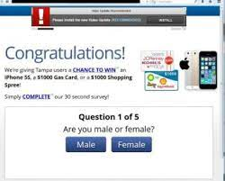
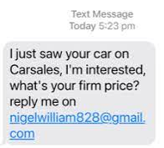
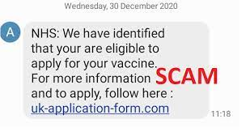
Other types of scams
There are a number of common scams that rely on tricking or manipulating people into paying money or volunteering personal details rather than by hacking your online accounts.
These include dating scams, classified scams, shopping scams, technician and trade scams, inheritance scams, and lottery prize scams and lately Covid -19 Scams.
Notes:
→ Vaccination scams
Scammers are requesting payment for vaccines or for early access to vaccines.
Scammers are offering to mail vaccines.
Scammers are offering to pay money as an investment opportunity in the Pfizer vaccine.
Scammers are creating fake surveys related to vaccines that offer prizes or early access.
If you have been scammed or have seen a scam, you can make a report on the Scamwatch website, and find more information about where to get help.

Slide 26
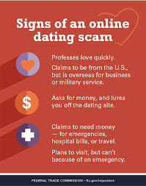
Dating and romance scams
There are many scammers who take advantage of people looking for romantic partners via dating websites and social media.
They pretend to be prospective companions. They play on your emotional triggers to get you to provide money, gifts or personal details.
Examples: Platforms include Facebook and various dating apps.
Notes:
Romance scams
This is also known as ‘catfishing’.
Romance scams take advantage of people who are looking for romantic partners, often via social media or dating sites. They pretend to be interested in the person in order to gain money and information. In some cases, it can be hard to tell if the person is real or not. In many cases, they may go to elaborate lengths to make the person believe they are real.

Slide 27
What to look out for
Dating scammers may express strong emotions for you quickly and suggest you communicate away from the website, via phone, email or instant messaging.
Once they have gained your trust they may ask you (or emotionally manipulate you) to send money, gifts or your banking/credit card details.
They may also ask you to send pictures or videos of yourself, possibly of an intimate nature.
Notes:
→ Scammers typically create fake online profiles designed to lure you in. They may use a fictional name, or falsely take on the identities of real, trusted people such as military personnel, aid workers or professionals working abroad. Dating scams account for a significant amount of financial loss in Australia.
→ Once they have gained your trust they will start asking for money and gifts.
ROMANCE SCAM
Between 00:01 on Saturday 21 August 2021 and 23:59 on Tuesday 28 September 2021
A lady met a guy on a dating site Tinder, in early August 2021. They were getting on well. He told me his name was Mike and that he grew up in the Hornsby area and was working FIFO (Fly In Fly Out) to Indonesia and was stuck in Indonesia currently due to the borders been closed.
She gained his trust and started sending him money to help support him until he can return to Australia. MADE 9 TRANSFERS TOTALLING $34875

Slide 28
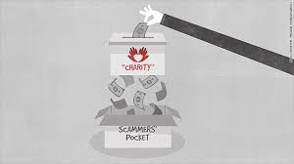
Financial scams
Online shopping and classified scams involve scammers pretending to be legitimate sellers, either with a fake website or a fake ad on a genuine retailer site.
Charity scammers impersonate genuine charities and ask for donations (online or door-to-door). They will often exploit recent natural disasters or tragedies. They may have fake emails or identification cards claiming to be from established charities such as Red Shield or World Vision
If you have been scammed or have seen a scam, you can make a report on the Scamwatch website, and find more information about where to get help.
Notes:
PUPPY DOG SCAM – FACEBOOK MARKET PLACE
A lady found the Facebook page 'Australian Shepherds for sale' and contacted them via Facebook Messenger. After back and forth messaging, the lady paid the scammer a deposit of $500 via direct bank transfer.
The last contact the lady had with the scammer was via Facebook Messenger, where the scammer stated that they had been stopped on the journey, from Medowie to Dee Why, by RSPCA rangers, who confiscated the puppy. The scammer then asked the lady for more money in order to get the puppy back, to which the lady refused.
The lady though it was sus. After police checked the phone number provided was St Vincent's Private Hospital, Melbourne.
_________________________________
Make sure you buy from a legit business. If the price or value is too good to be true it probably is.
Classified scams such as Car Sales. Com. You get emails from prospective buyers offering a ridiculous amount of money but they want the car before you get the cash. Don’t send any money in advance.
The website is authentic but the people answering your ads aren’t.
There are many fake websites with adverts on Facebook offering cheap products. BEWARE. Do you homework to see if it’s a legitimate site.

Slide 29
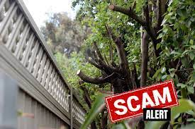
Technician and trades scams
Scammers impersonate technicians and tradespeople online, via phone and door-to-door
They may impersonate telecommunications or NBN workers and seek payment for service provision or to prevent immediate service disconnection
Scammers have gone door-to-door offering discounted tree-trimming, painting and gardening services - then insisting on higher payment.
Notes:
There have been cases where tree-trimming businesses have offered discount rates ‘today only as we’re in your neighbourhood’. Upon completion of the job they ask for more money
on the grounds that the job was bigger than they thought. On occasion they have even taken older community members to the bank to get more money for them.
Its been a bit quiet due to lockdowns etc, but summer is coming, borders are opening. Be on the lookout. If in doubt speak with a trusted friend or family member.

Slide 30
Protecting against technician and trades scams
NBN and other technicians carry ID and you can request to see it – but pay close attention as these can be fake
Never give an unsolicited caller who claims to be from NBN or a telecommunications company remote access to your computer
Ask family or friends to recommend a trusted technician or tradesperson if you need one – don’t accept door-to-door offers
Do an independent check online about tradespeople and service providers. Don’t go to a site on a card they gave you - it may be fake

Slide 31
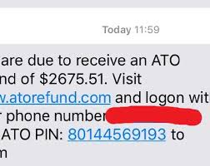
Unexpected and easy money
There are a range of scams that involve tricking people into believing that they will get rich quick!
This includes scammers telling you that you have received an inheritance from someone overseas, you have won a prize, or you have an unexpected tax refund.
They may also promote unlawful Pyramid and other ‘get rich quick’ schemes

Slide 32
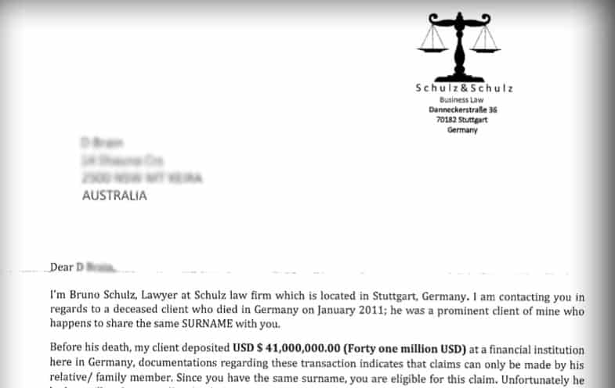
Inheritance Scam
Who is the deceased person – Claims to have same surname
A lot of money. That’s to grab your attention
What?? He has no other family??

Slide 33
Wrapping up…
Scammers are constantly adapting to new technologies, but their aim is the same – to steal your identity and/or assets.
Scammers quickly exploit emerging issues (NBN scams, Bitcoin investment scams, bushfire charity scams, COVID-19 scams) but their aim is the same – to steal your identity and/or assets.
If someone contacts you and asks for your details always independently check online and verify they are legitimate.
Report suspected scams (see following slides)
If it sounds too good to be true – it probably is

Slide 34
Protection Tips summary
Be aware that scams exist. Know who you're dealing with.
Do not open suspicious texts, pop-up windows or click on links or attachments in emails – delete them.
Don't respond to phone calls about your computer asking for remote access – hang up.
Keep personal information, mobile devices and computers secure.
Secure devices, Bluetooth and wifi with different passwords (at least 12 characters) for each account
Maintain up-to-date anti-virus software
Don’t use public wifi for secure transactions
Review privacy and security settings on social media
Don’t share details that reveal your identity
Beware of requests for personal details or money.
Be wary of unusual payment requests.
Be careful when shopping online. Use secure sites.
Verify the identity and integrity of all service providers
Notes:
Acronym
S – stay safe – don’t give out your personal information to people /places you don’t know or haven’t verified
M – don’t Meet up – meeting up with someone online could be dangerous.
A – Accepting Files – accepting emails, files ect from people or companies you don’t know can cause you a lot of problems later down the track
R – Reliable – check information before you believe it is the person or website you are dealing with
T – Tell someone – If you have been scammed, be sure to tell someone, report it to police. Don’t be embarrassed as it can happen to anyone.

Slide 35
REPORT SCAMS (INFORM COMMUNITY AND DISRUPT SCAMS)
Type of incident | Agency
Banking | Your bank or financial institution
Centrelink, Medicare, Child Support and myGov related scams | Department of Human Services Scams and Identity Theft Helpdesk - call 1800 941 126
Cybercrime | Australian Cyber Security Centre (ACSC) https://www.cyber.gov.au/
Financial and investment scams Report scams to the ACCC via the ‘report a scam’ page | Australian Securities and Investments Commission https://asic.gov.au/ Scamwatch https://www.scamwatch.gov.au/get-help/where-to-get-help
Fraud and theft | Your local police – Or call 131 444
Image based abuse (sextortion), cyberbullying and illegal content | Office of the eSafety Commissioner https://www.esafety.gov.au/
Spam | Australian Communications and Media Authority: https://www.acma.gov.au/
Tax related scams | Australian Taxation Office https://www.ato.gov.au/

Slide 36
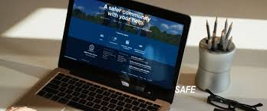
REPORTING CRIME
Dee Why Police Station 9971 3399
Police Assistance Line 131 444
Crime Stoppers 1800 333 000
Online Community Portal
Emergencies 000

Slide 37
Did we achieve our workshop aims?
Promote awareness of the types of scams occurring in our community
Understand how scammers operate so we can protect ourselves against them
Know what to do if we experience a scam

Slide 38
QUESTIONS

